Slide 1
Movie Recommendation
System
Ziyan Saleem

Slide 2
Outline
Introduction to Movie recommendation system
Sample Data
Data Exploration
Recommendation systems
Content Based
Collaborative filtering
Hybrid
Summary and Future work

Slide 3
Introduction to Movie Recommendation System

Slide 4
Why Movie Recommendation System?
The primary goal of movie recommendation systems is to filter and predict only those movies that a corresponding user is most likely to want to watch.

Slide 5
Sample Data

Slide 6
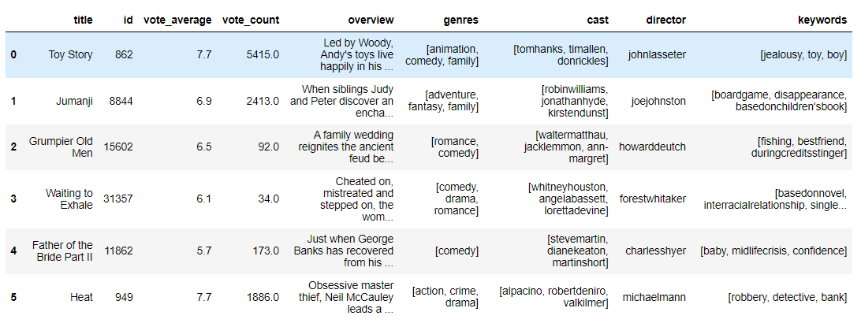
Dataset
Notes:
Movie lens
Combined Dataset—--
Metadata , Ratings , cast and crew

Slide 7
Data exploration

Slide 8
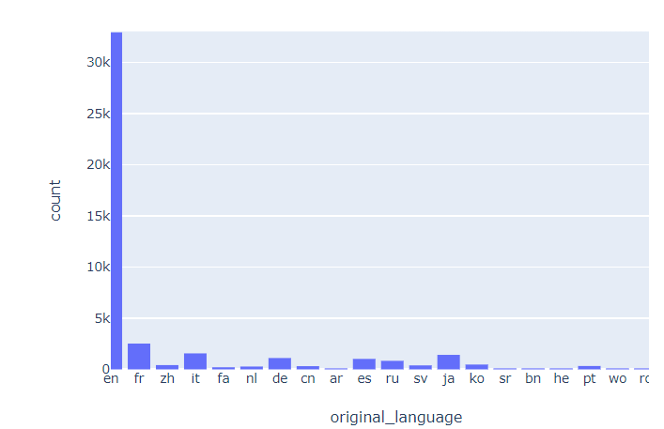
What are they saying?
Notes:
Most of them are english movies
Then comes french

Slide 9
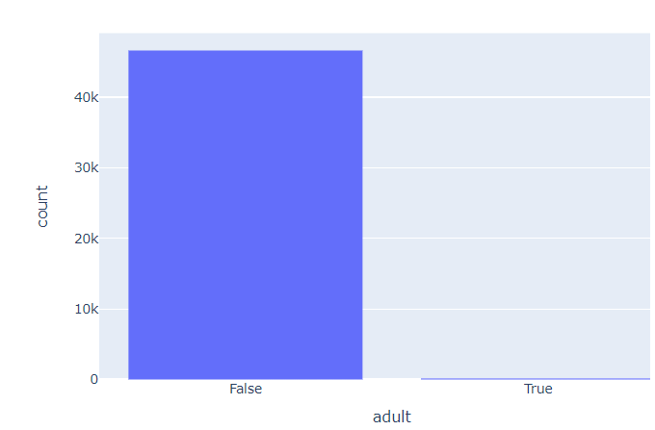
Can I watch this?
Notes:
Only few adult movies are in this dataset

Slide 10
Recommendation System

Slide 11
Collaborative Filtering
Collaborative filtering is a technique that can filter out items that a user might like on the basis of reactions by similar users.It works by searching a large group of people and finding a smaller set of users with tastes similar to a particular user. It looks at the items they like and combines them to create a ranked list of suggestions
Notes:
SVD constructs a matrix with the row of users and columns of items and the elements are given by the users' ratings. Singular value decomposition decomposes a matrix into three other matrices and extracts the factors from the factorization of a high-level (user-item-rating) matrix

Slide 12
Content Based Recommender System(CBRS)
CBRS mainly works by analyzing the features of an item preferred by a user and tries to identify the similarity between them. The preference of user is calculated based on his/her choice in the past. Similar items are identified based on the characteristics of compared items
Notes:
Simple Recommender
Cosine similarity —Count vector—Tf - idf vectorizer

Slide 13
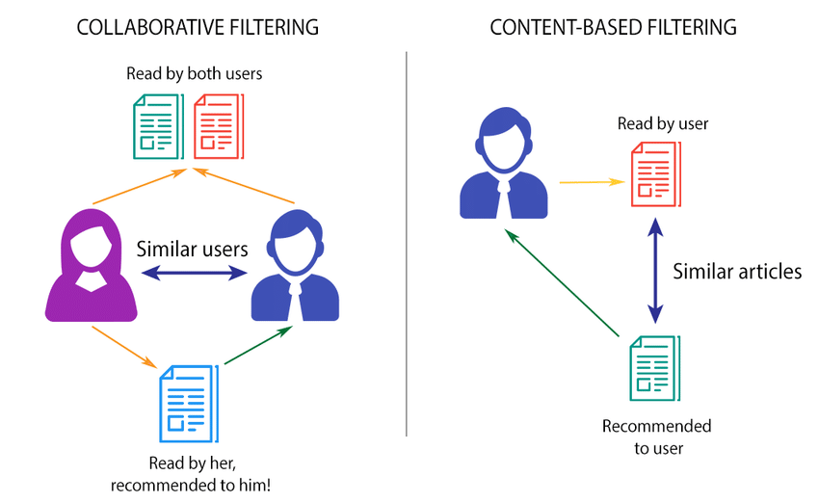
Content based & Collaborative Filtering

Slide 14
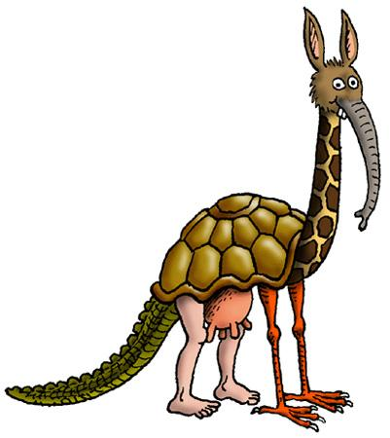
Hybrid

Slide 15
Hybrid
We see that each method has its strength. It would be best if we can combine all those strengths and provide a better recommendation. This idea leads us to another improvement of the recommendation, which is the hybrid method. For example, we can combine the content-based and collaborative filtering recommendations together to leverage both domain features.

Slide 16
Results

Slide 17
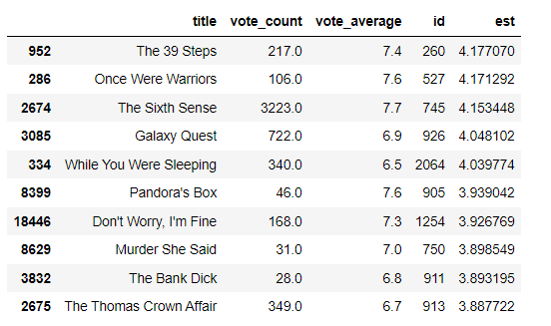
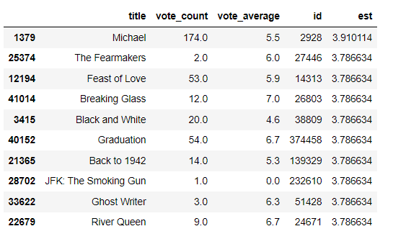
Collaborative Filtering
Hybrid filtering

Slide 18
Summary &
Future work

Slide 19
Conclusion
These recommendation system helps us in recommending movies according to the users.
We Used 4 types of recommendation system on MovieLens dataset in this thesis.
Content based recommendation system was done by Calculating cosine similarity, taking in consideration of genres , cast and crew.
Collaborative Filtering was done by considering the similar users and watch history.
The accuracy was calculated by RMSE.
Hybrid was done by Considering both Content based And Collaborative Filtering recommender system.

Slide 20
Questions?

Slide 21
References
Implementation and Evaluation of Movie Recommender Systems Using Collaborative Filtering - Salam Salloum and Dananjaya Rajamanthri
A personalised movie recommendation system based on collaborative filtering -V. Subramaniyaswamy*, R. Logesh, M. Chandrashekhar and Anirudh Challa
Movie Recommendation System Using Collaborative Filtering - Ching-Seh (Mike) Wu , Deepti Garg

Slide 22
Thank You!

